Slide 1
Understanding the role of nitrogen availability and acquisition strategy on plant responses to global change
Evan A. Perkowski

Slide 2
Adapted from Fig 5.12 in IPCC (2021)
Notes:
x-axis = Major carbon flux components between the atmosphere and biosphere

Slide 3
Photosynthesis = largest carbon flux between the atmosphere and land surface
Adapted from Fig 5.12 in IPCC (2021)
Notes:
The "Land in” component is driven by photosynthesis, suggesting that photosynthesis is the largest carbon flux between the atmosphere and biosphere

Slide 4
Photosynthesis = largest carbon flux between the atmosphere and land surface
Terrestrial biosphere models must accurately predict photosynthetic fluxes at multiple scales to reliably predict ecosystem responses to environmental change
Adapted from Fig 5.12 in IPCC (2021)
Notes:
As a result…

Slide 5
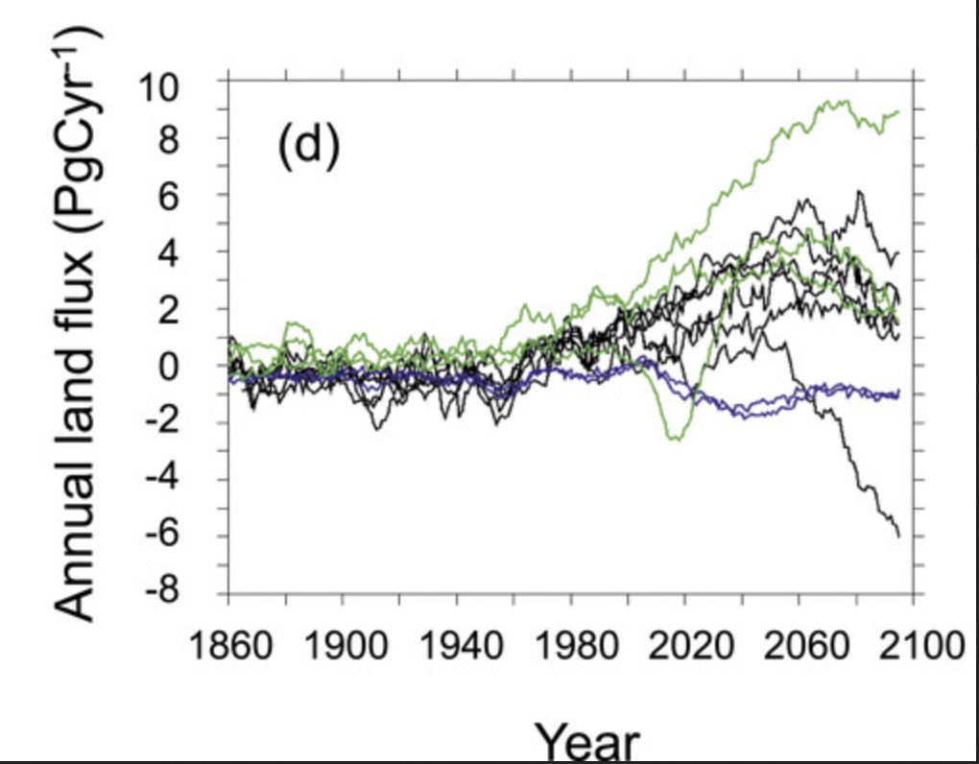
Terrestrial biosphere model carbon flux simulations converge under past environmental conditions
Carbon sink
(Flux in > flux out)
Carbon source
(Flux in < flux out)
Friedlingstein et al. (2014) Journal of Climate
Notes:
x-axis = year
y-axis = land carbon flux
Fluxes
Agreement between model simulations are likely because these models were parameterized using historical climate data

Slide 6
However, model simulations exhibit strong divergence under future environments
Carbon sink
(Flux in > flux out)
Carbon source
(Flux in < flux out)
Friedlingstein et al. (2014) Journal of Climate
Notes:
Many possible explanations to explain this phenomenon
One thought is that this divergence is driven by the lack of the nitrogen cycle in terrestrial biosphere models,
but this could also be driven by uncertainty in the response of photosynthetic acclimation responses to novel environments

Slide 7
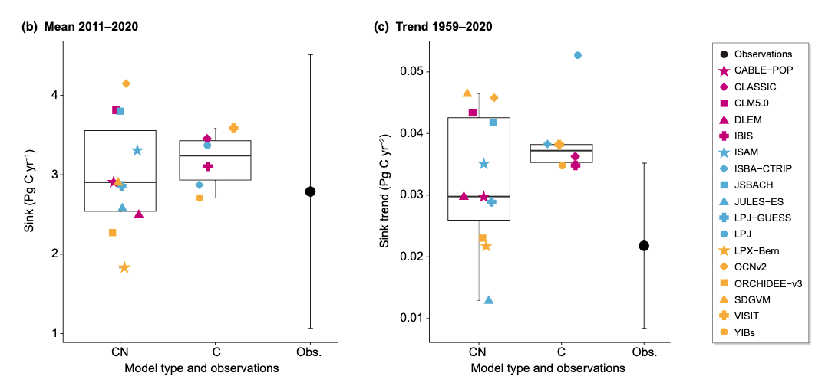
This divergence may be due to a difference in how these models formulate processes that regulate C and N cycles
Stocker et al. (2024) New Phytologist

Slide 8
This divergence may be due to a difference in how these models formulate processes that regulate C and N cycles
Stocker et al. (2024) New Phytologist
Notes:
While CN models more accurately quantify carbon sink trends compared to models that only include the C cycle, the variability in simulated C sink trends across CN-models suggests that we need to better understand mechanisms that drive the processes that link C-N cycles to consistently model these processes

Slide 9
What are the mechanisms that explain plant physiological responses to environmental change across nutrient availability gradients?
Plant nutrient acquisition
Photosynthetic acclimation

Slide 10


Plant nitrogen acquisition and photosynthesis are two processes in terrestrial ecosystems where C and N are coupled
CO₂
Photosynthesis
Schematic adapted from Brzostek et al. (2014) Biogeosciences
Notes:
Regardless of acquisition strategy,
plants must allocate carbon belowground to acquire nitrogen,
implying an inherent carbon cost associated with acquiring nitrogen

Slide 11
Plant nitrogen acquisition and photosynthesis are two processes in terrestrial ecosystems where C and N are coupled
CO₂
Photosynthesis
C_{transfer}
C_{growth}
Schematic adapted from Brzostek et al. (2014) Biogeosciences
Notes:
Regardless of acquisition strategy,
plants must allocate carbon belowground to acquire nitrogen,
implying an inherent carbon cost associated with acquiring nitrogen

Slide 12
Plant nitrogen acquisition and photosynthesis are two processes in terrestrial ecosystems where C and N are coupled
CO₂
Photosynthesis
C_{transfer}
C_{growth}
N_{acq}
N_{available}
Schematic adapted from Brzostek et al. (2014) Biogeosciences
Notes:
Regardless of acquisition strategy,
plants must allocate carbon belowground to acquire nitrogen,
implying an inherent carbon cost associated with acquiring nitrogen

Slide 13
Plant nitrogen acquisition and photosynthesis are two processes in terrestrial ecosystems where C and N are coupled
CO₂
There are inherent carbon costs of acquiring nitrogen
Photosynthesis
C_{transfer}
C_{growth}
N_{acq}
N_{available}
Schematic adapted from Brzostek et al. (2014) Biogeosciences
Notes:
Regardless of acquisition strategy,
plants must allocate carbon belowground to acquire nitrogen,
implying an inherent carbon cost associated with acquiring nitrogen

Slide 14
Guiding questions for today’s talk
How do carbon costs to acquire nitrogen vary across resource availability gradients?
What is the role of nitrogen acquisition strategy in modulating carbon costs to acquire nitrogen across resource availability gradients?
What is the role of nitrogen availability in modulating plant photosynthetic responses to global change?
Are plant responses to global change associated with changes in the cost of acquiring nitrogen?

Slide 15
Guiding questions for today’s talk
How do carbon costs to acquire nitrogen vary across resource availability gradients?
What is the role of nitrogen acquisition strategy in modulating carbon costs to acquire nitrogen across resource availability gradients?
Part I
What is the role of nitrogen availability in modulating plant photosynthetic responses to global change?
Are plant responses to global change associated with changes in the cost of acquiring nitrogen?

Slide 16
Guiding questions for today’s talk
How do carbon costs to acquire nitrogen vary across resource availability gradients?
What is the role of nitrogen acquisition strategy in modulating carbon costs to acquire nitrogen across resource availability gradients?
Part I
What is the role of nitrogen availability in modulating plant photosynthetic responses to global change?
Are plant responses to global change associated with changes in the cost of acquiring nitrogen?
Part II

Slide 17
Increasing soil nitrogen availability may decrease costs to acquire nitrogen due to increased per-root nitrogen uptake
CO₂
Photosynthesis
C_{transfer}
C_{growth}
N_{acq}
Pt. I
N_{available}
Schematic adapted from Brzostek et al. (2014) Biogeosciences
Notes:
Importantly, carbon costs to acquire nitrogen are dynamic and likely change with changing aboveground or belowground environmental conditions.

Slide 18
Increasing soil nitrogen availability may decrease costs to acquire nitrogen due to increased per-root nitrogen uptake
CO₂
Photosynthesis
C_{transfer}
C_{growth}
N_{acq}
Pt. I
N_{available}
Schematic adapted from Brzostek et al. (2014) Biogeosciences
Notes:
Importantly, carbon costs to acquire nitrogen are dynamic and likely change with changing aboveground or belowground environmental conditions.

Slide 19
Increasing soil nitrogen availability may decrease costs to acquire nitrogen due to increased per-root nitrogen uptake
Carbon cost to
acquire nitrogen
N availability
Pt. I
Schematic adapted from Brzostek et al. (2014) Biogeosciences
Notes:
Importantly, carbon costs to acquire nitrogen are dynamic and likely change with changing aboveground or belowground environmental conditions.

Slide 20
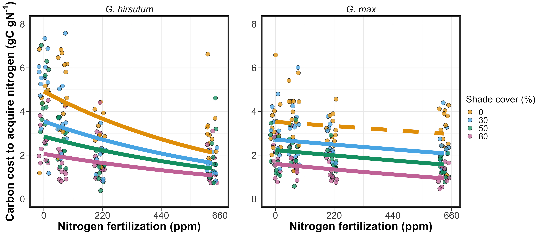


Carbon costs to acquire nitrogen decrease with increasing fertilization
Pt. I
Perkowski et al. (2021) Journal of Experimental Botany

Slide 21
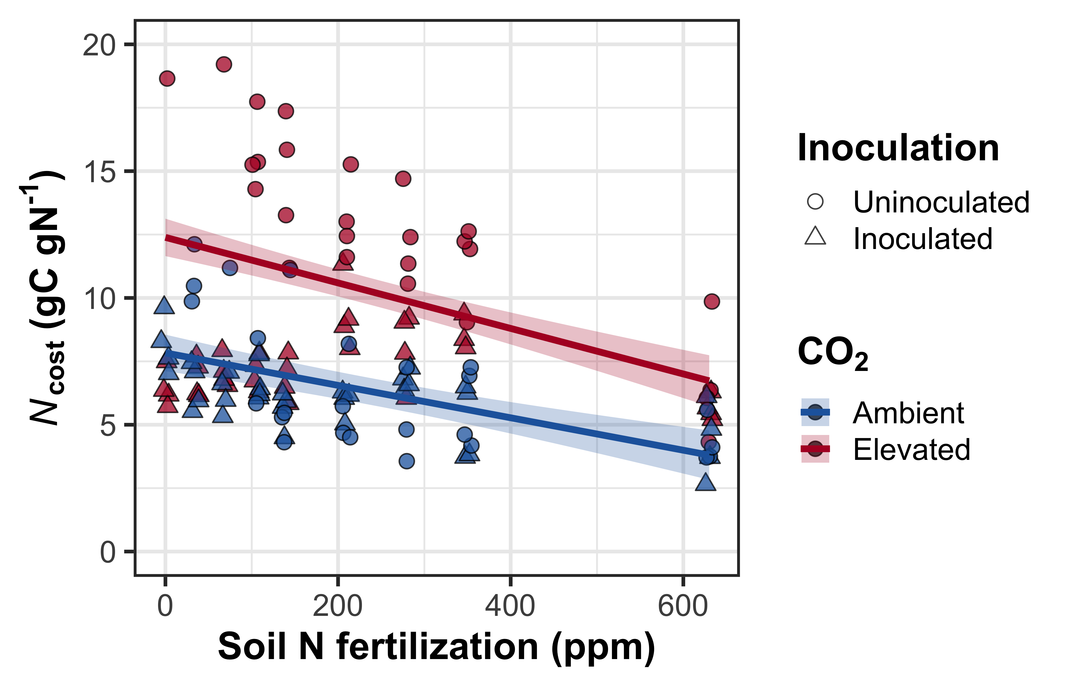
Carbon costs to acquire nitrogen decrease with increasing fertilization
Pt. I
Perkowski et al. (in review)

Slide 22
Increasing nitrogen availability decreases carbon costs to acquire nitrogen in the field, too!
Carbon cost of
nitrogen acquisition
relative to water
Pt. I

Slide 23
Effects of nitrogen availability on costs to acquire nitrogen may depend on acquisition strategy
Direct uptake
Nitrogen fixation
Carbon cost to
acquire nitrogen
N availability
Pt. I
Schematic adapted from Brzostek et al. (2014) Biogeosciences
Notes:
Importantly, carbon costs to acquire nitrogen are dynamic and likely change with changing aboveground or belowground environmental conditions.

Slide 24
Effects of nitrogen availability on costs to acquire nitrogen may depend on acquisition strategy
Direct uptake
Nitrogen fixation
Carbon cost to
acquire nitrogen
N availability
Pt. I
Schematic adapted from Brzostek et al. (2014) Biogeosciences
Notes:
Importantly, carbon costs to acquire nitrogen are dynamic and likely change with changing aboveground or belowground environmental conditions.

Slide 25
Resource optimization: plants may switch dominant mode of nitrogen acquisition if one strategy becomes less costly
Direct uptake
Nitrogen fixation
Carbon cost to
acquire nitrogen
N availability
Pt. I
Schematic adapted from Brzostek et al. (2014) Biogeosciences
Notes:
Importantly, carbon costs to acquire nitrogen are dynamic and likely change with changing aboveground or belowground environmental conditions.

Slide 26
Increasing nitrogen fertilization decreases carbon costs to acquire nitrogen less strongly in the N-fixing species
Pt. I
Perkowski et al. (2021) Journal of Experimental Botany

Slide 27
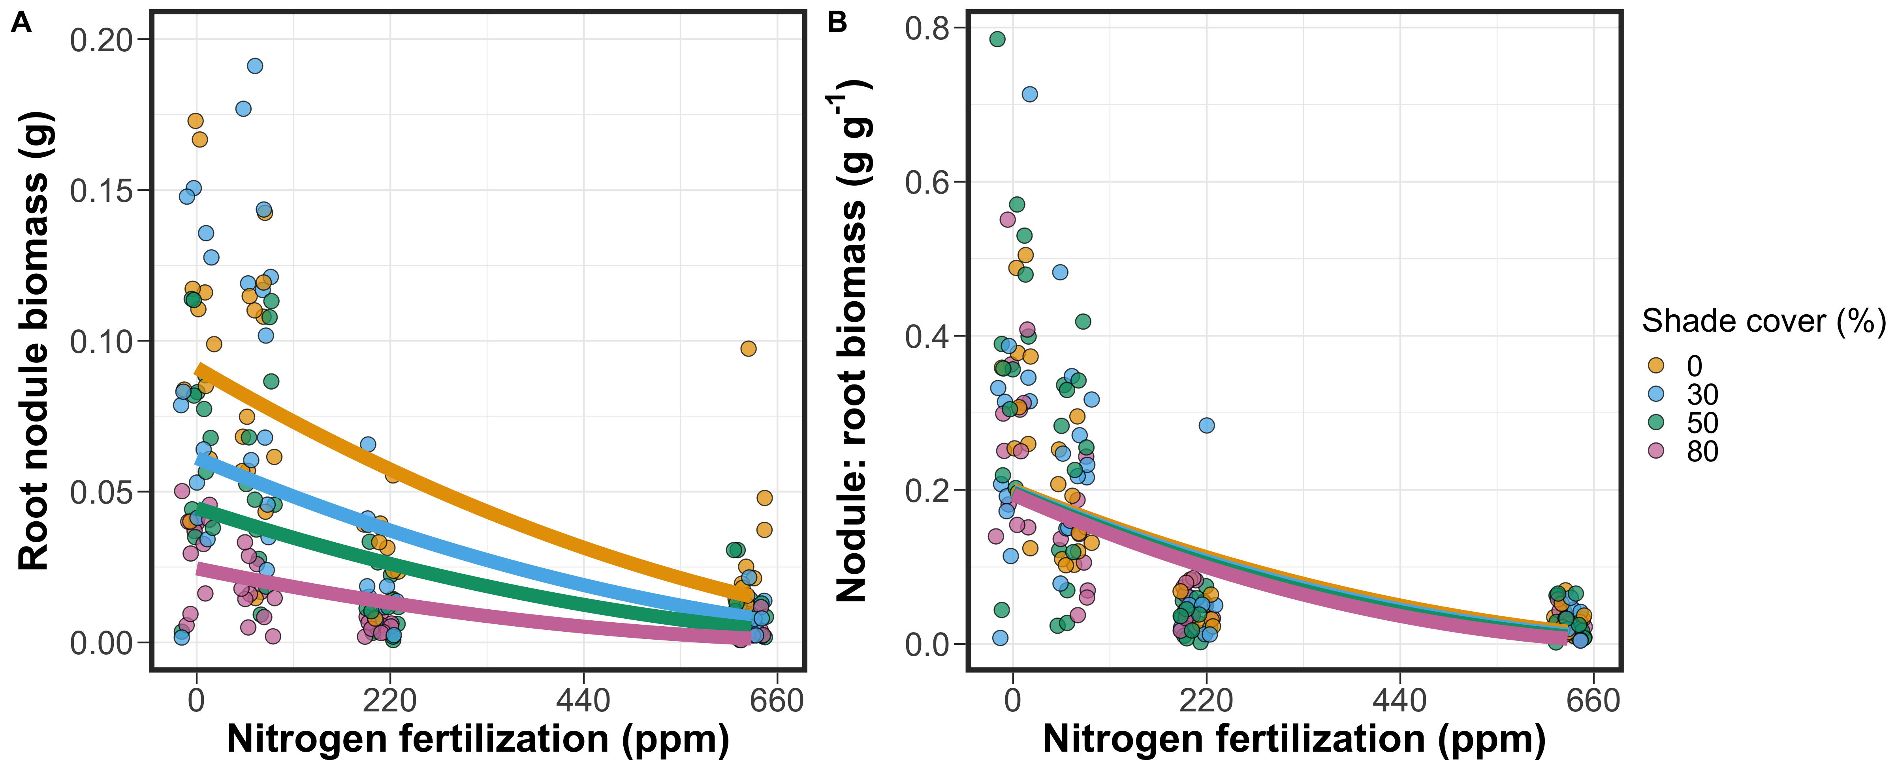
Soybean invested more strongly in direct uptake pathways with increasing nitrogen fertilization (relative to N fixation)
Pt. I
Perkowski et al. (2021) Journal of Experimental Botany

Slide 28
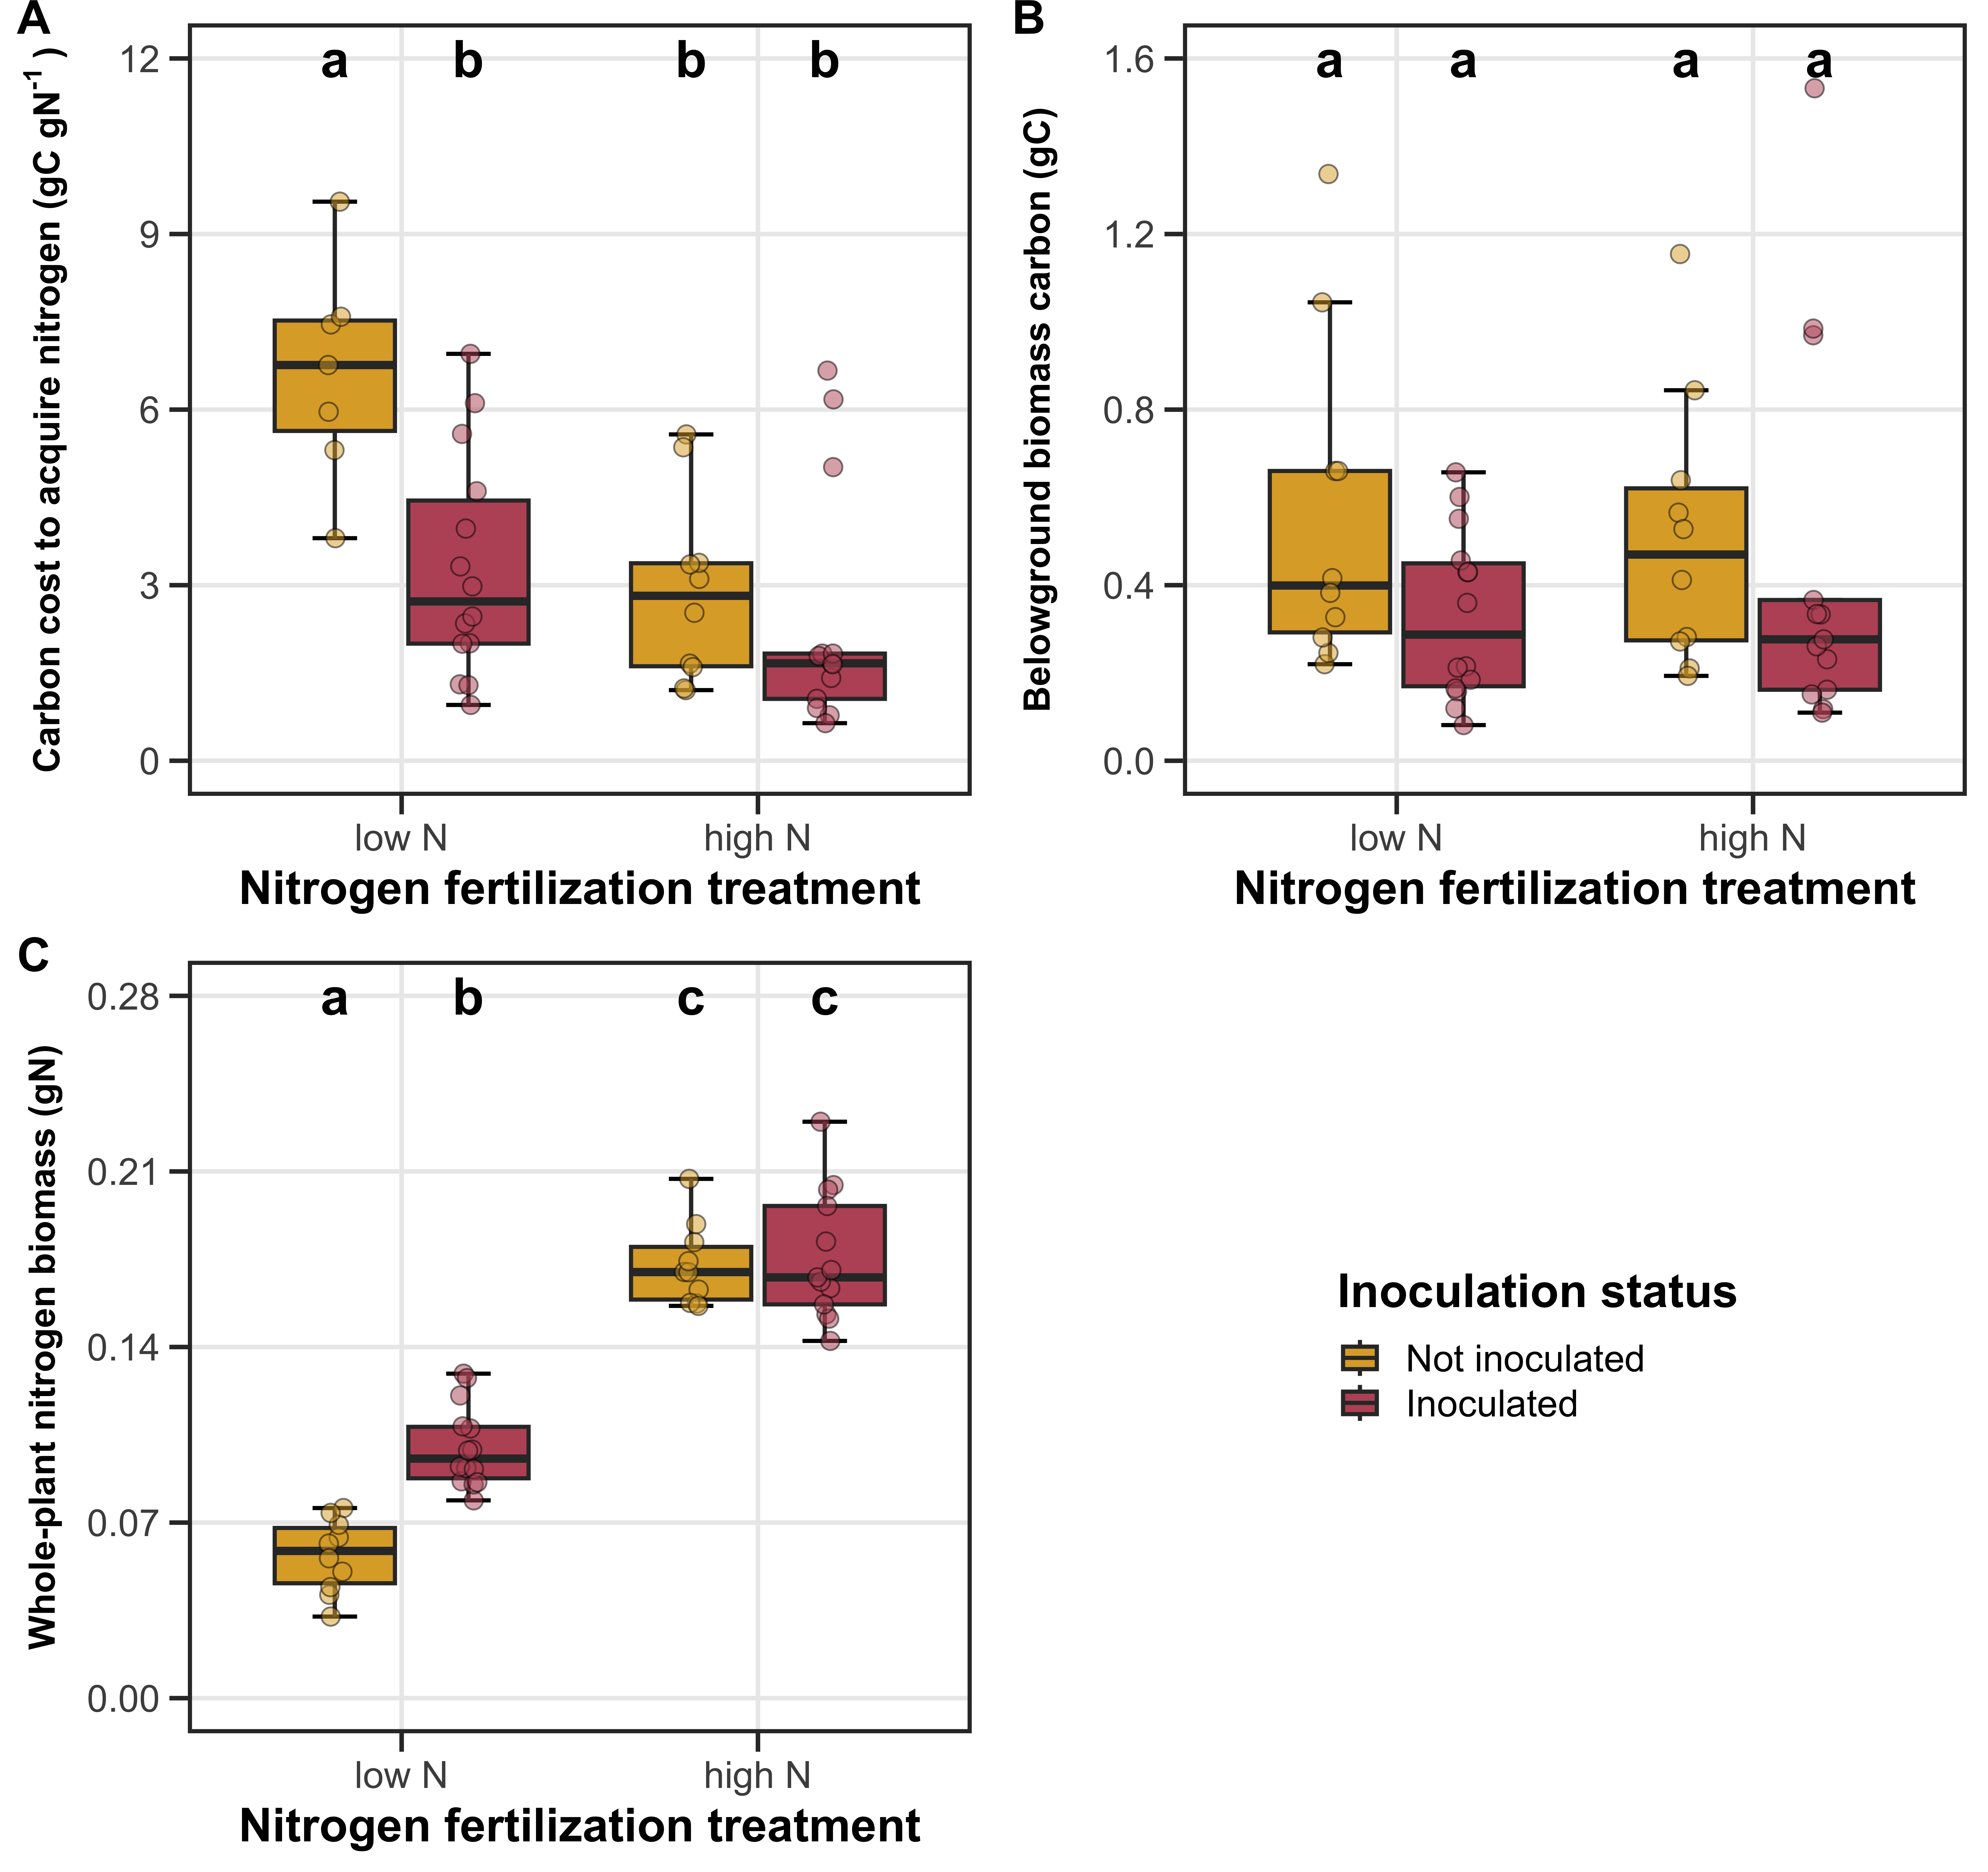
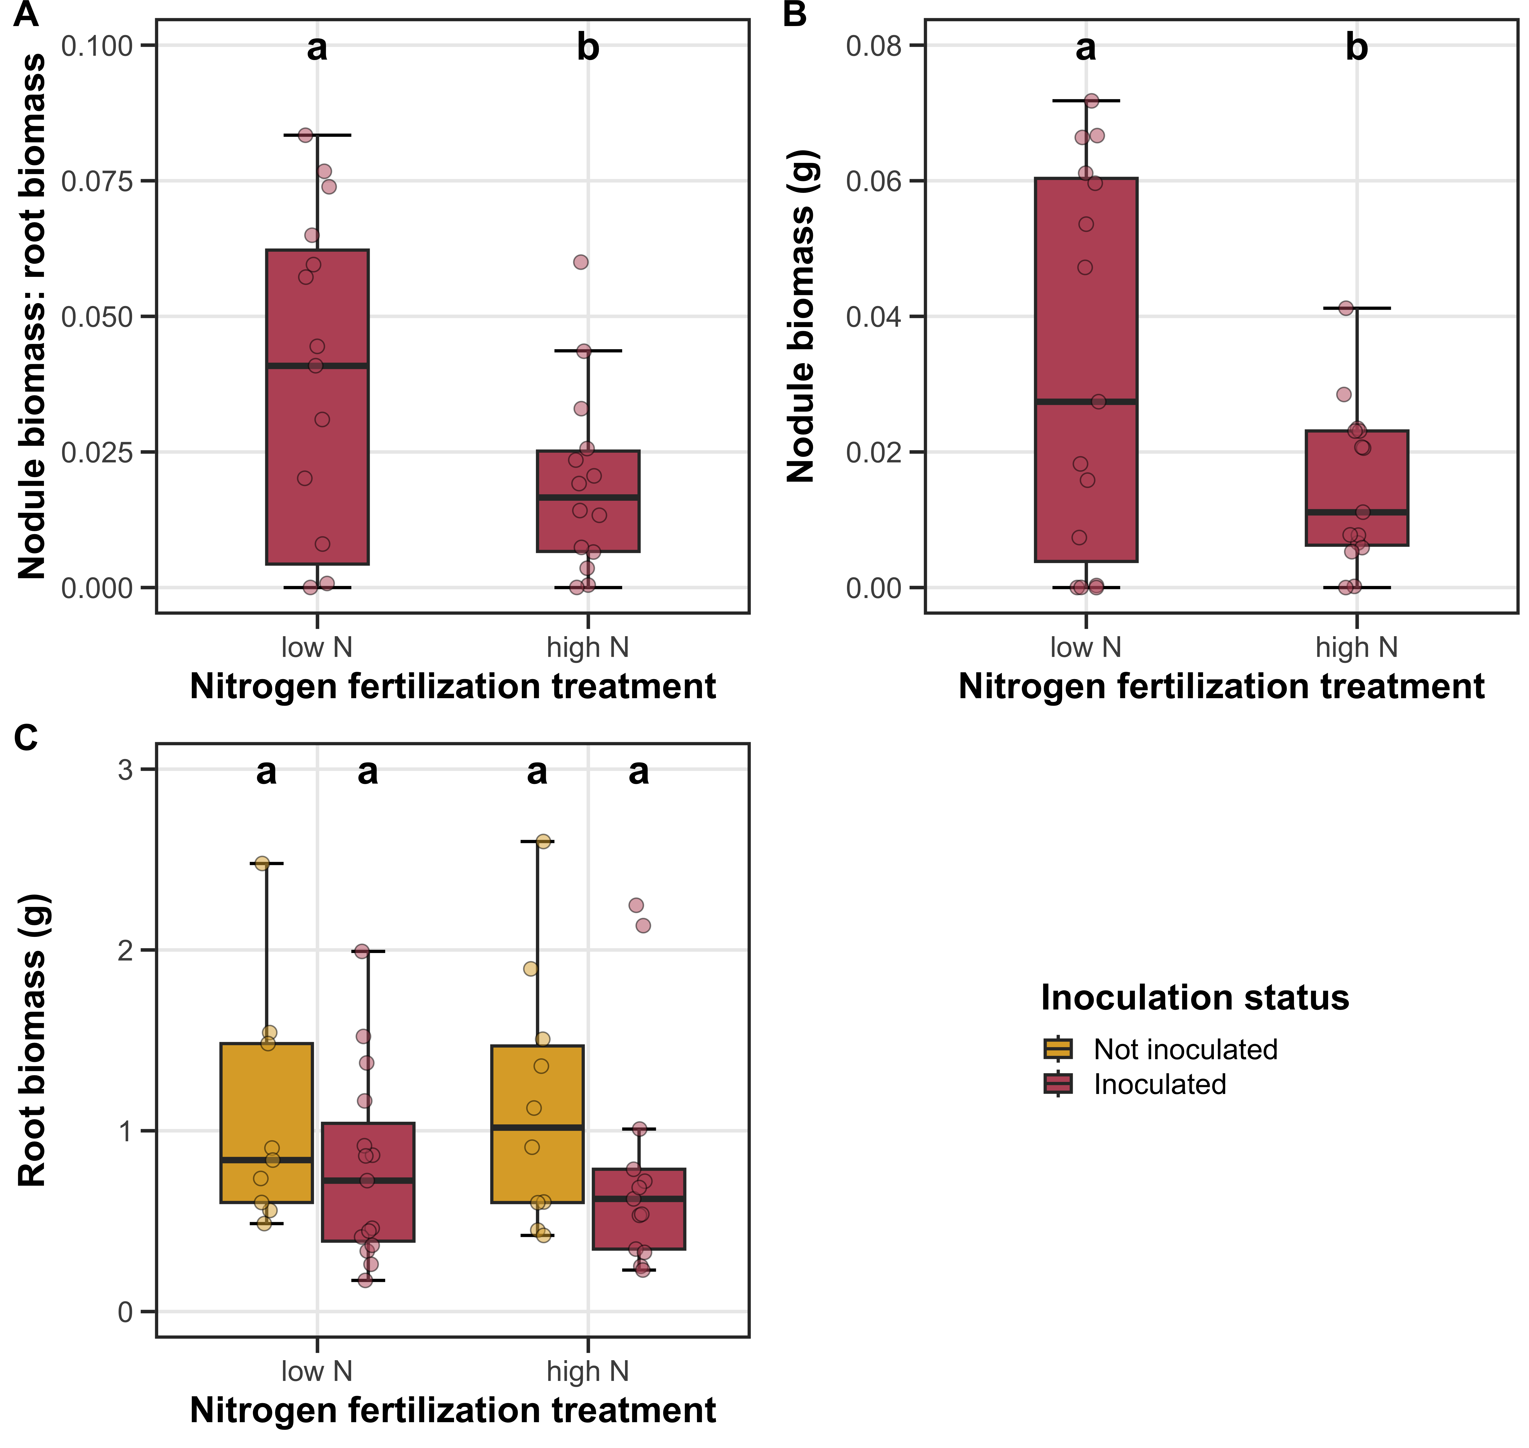
Similar responses are observed when species differences in growth form/duration are controlled
Pt. I
Perkowski et al. (2024) AoB Plants

Slide 29
Factors that increase demand for building photosynthetic enzymes (e.g., light) may increase costs to acquire nitrogen
CO₂
Photosynthesis
C_{transfer}
C_{growth}
N_{acq}
Pt. I
N_{available}
Schematic adapted from Brzostek et al. (2014) Biogeosciences
Notes:
Importantly, carbon costs to acquire nitrogen are dynamic and likely change with changing aboveground or belowground environmental conditions.

Slide 30
Increasing light availability increases carbon costs to acquire nitrogen
Pt. I
Perkowski et al. (2021) Journal of Experimental Botany
Notes:
Larger increase in whole plant nitrogen biomass than belowground carbon biomass

Slide 31
Increasing atmospheric CO₂ concentrations also increase carbon costs to acquire nitrogen
Perkowski et al. (in review)

Slide 32
Main takeaways
N acquisition strategy modifies the effects of N availability on carbon costs for nitrogen acquisition
N uptake is maximized by ‘choosing’ the strategy that minimizes C expenditure
Increasing demand to build photosynthetic enzymes increases the cost of acquiring N
Carbon cost to
acquire nitrogen
N availability
Pt. I

Slide 33
Main takeaways
Direct uptake
Nitrogen fixation
N acquisition strategy modifies the effects of N availability on carbon costs for nitrogen acquisition
N uptake is maximized by ‘choosing’ the strategy that minimizes C expenditure
Increasing demand to build photosynthetic enzymes increases the cost of acquiring N
Carbon cost to
acquire nitrogen
N availability
Pt. I

Slide 34
Main takeaways
N acquisition strategy modifies the effects of N availability on carbon costs for nitrogen acquisition
N uptake is maximized by ‘choosing’ the strategy that minimizes C expenditure
Increasing demand to build photosynthetic enzymes increases the cost of acquiring N
Carbon cost to
acquire nitrogen
N demand
Pt. I

Slide 35
Guiding questions for today’s talk
How do carbon costs to acquire nitrogen vary across resource availability gradients?
What is the role of nitrogen acquisition strategy in modulating carbon costs to acquire nitrogen across resource availability gradients?
Part I
What is the role of nitrogen availability in modulating plant photosynthetic responses to global change?
Are plant responses to global change associated with changes in the cost of acquiring nitrogen?
Part II

Slide 36
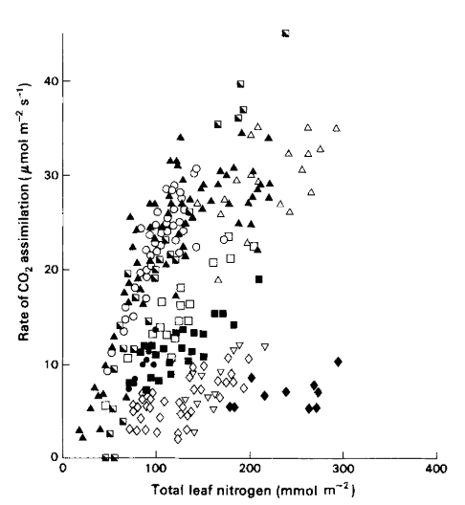
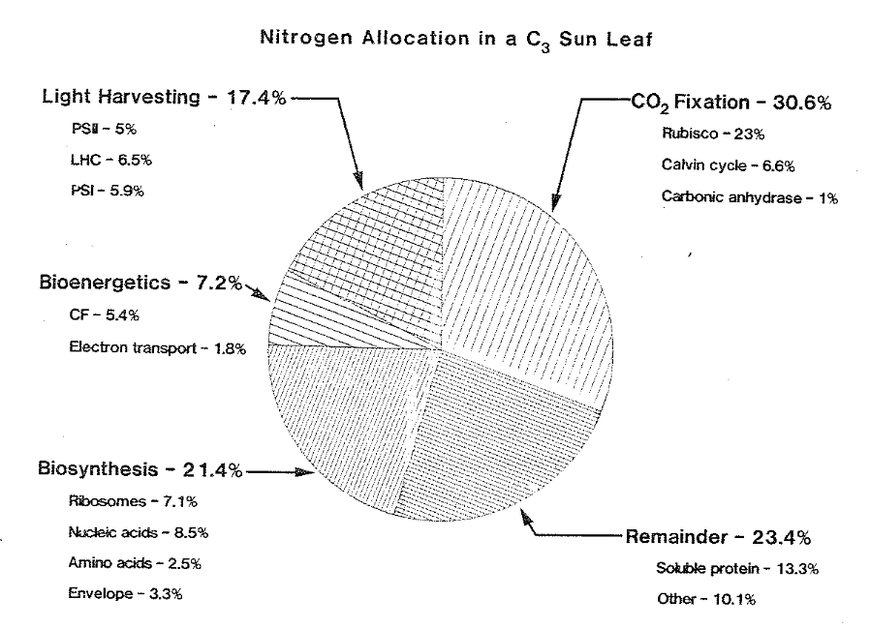
Terrestrial biosphere models predict leaf-level photosynthesis through its relationship with leaf nitrogen content
Evans (1989) Oecologia
Evans & Seemann (1989) Photosynthesis

Slide 37
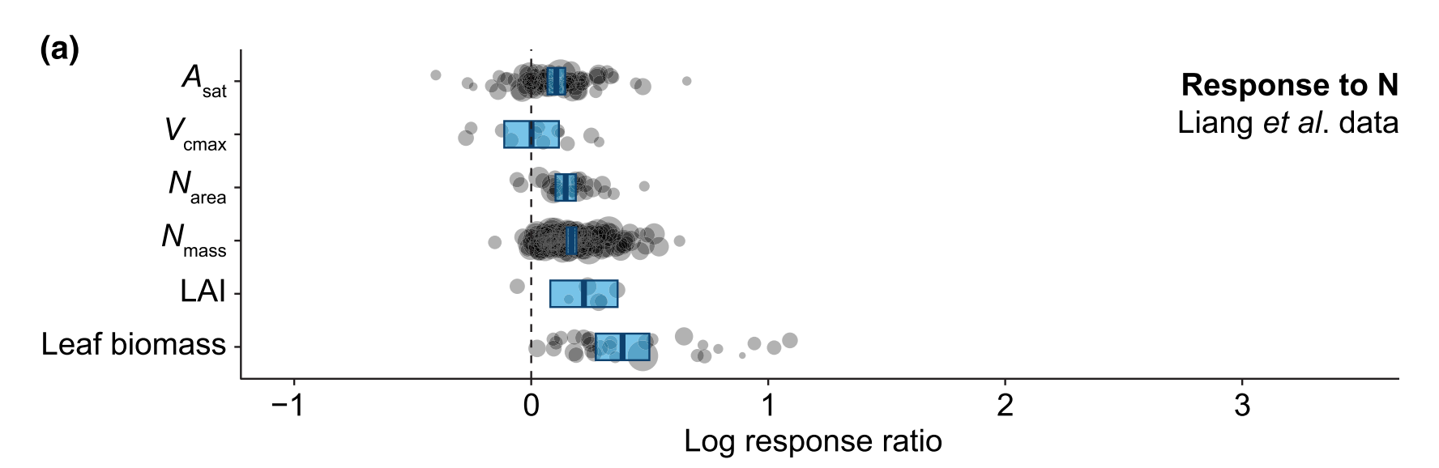
Increasing nitrogen availability increases leaf nitrogen content and photosynthesis… but not always photosynthetic capacity
Stocker et al. (2024) New Phytologist

Slide 38
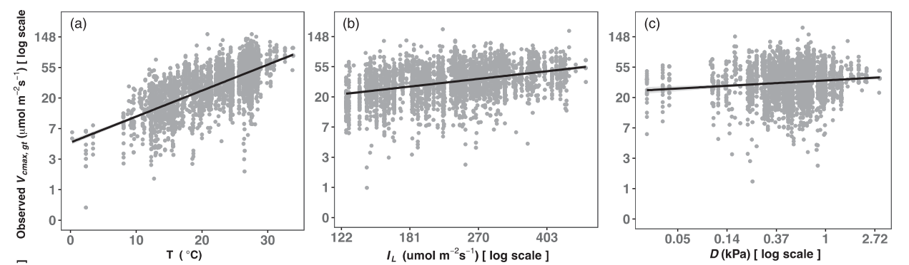
Furthermore, photosynthetic capacity can be predicted through climate variables independent of nitrogen availability
Dong et al. (2022) Journal of Ecology

Slide 39
Investment toward photosynthetic capacity is a product of interactions between climate and soil resource availability across environmental gradients
Notes:
While we know that variation in leaf nitrogen can be explained by soil nitrogen availability, climate, or plant traits, we do not have a firm grasp of what factors drive variance in leaf nitrogen content across environmental gradients.

Slide 40
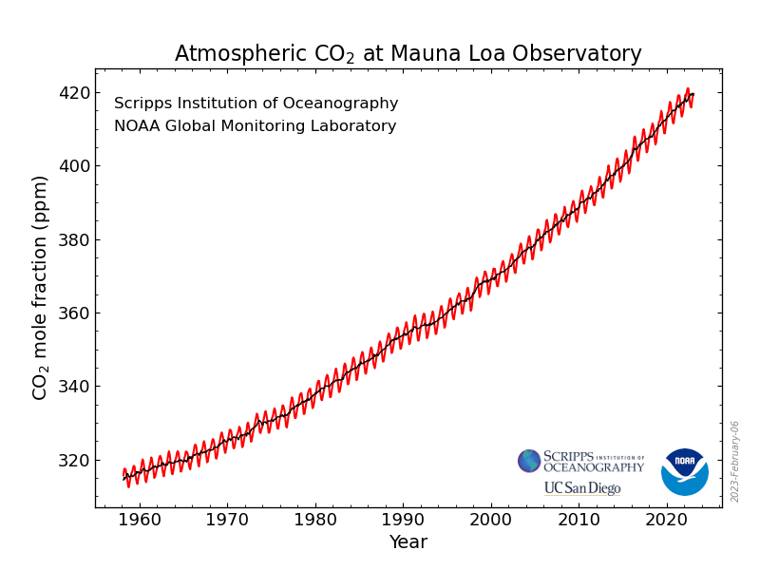
https://gml.noaa.gov/ccgg/trends/

Slide 41
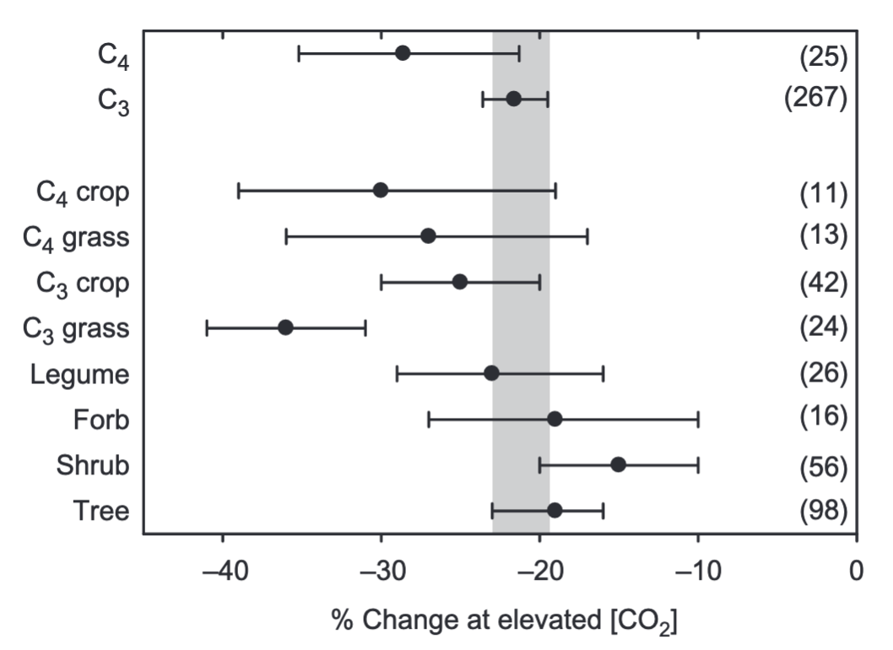
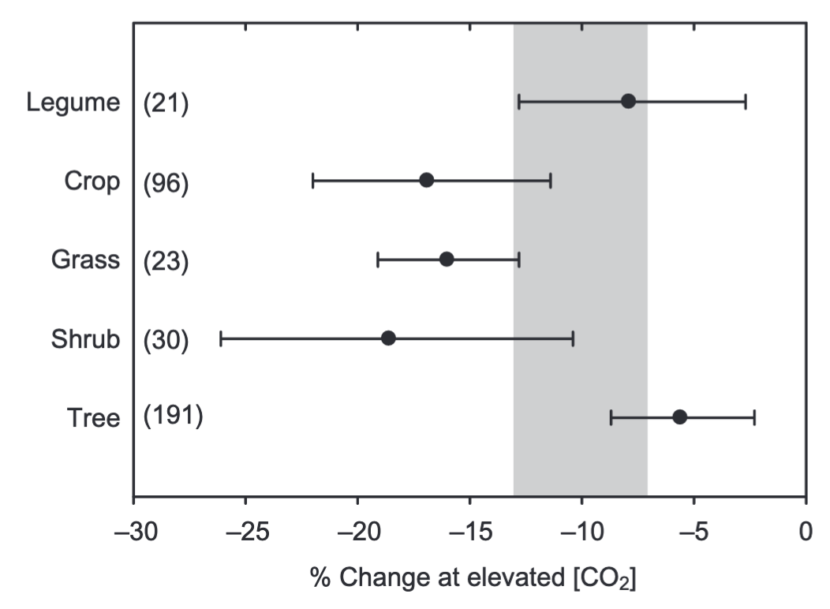
Plants grown under elevated CO₂ exhibit reductions in stomatal conductance and photosynthetic capacity
Stomatal conductance
Photosynthetic capacity
Ainsworth & Rogers (2007) Plant, Cell & Environment

